Slide 1
PHYSICAL DESIGN PRESENTATION
GENERAL PURPOSE SHIFT REGISTER

Slide 2
Physical Design QOR Evaluation Metrics:
1) Import design summary :
Block Name : Placement_done
SI No | Parameter | Values
1 | Number of cells | 32510
2 | Number of Hard Macros | 16
3 | Number of ports | 105
4 | Number of voltage domain | 01
5 | Number of Master clock | 02
6 | Number generated clock | 0
7 | Number of Modes | 01
8 | Number of corners | 01
9 | Number of scenarios | 01
10 | Total metal layers | 8 (M1-M8),with 2 MRDL
11 | Unresolved instances / Black boxes | 0

Slide 3
Physical Design QOR Evaluation Metrics:
2) Floorplan Summary :
Block Name :
SI No | Parameter | Values
1 | Total core area | 391890 Sq.units
2 | Core utilization | 63.46%
3 | Distance between core and die area | 5 units

Slide 4
Physical Design QOR Evaluation Metrics:
3) Port placement Summary and QOR :
Block Name :
Port Placement Summary
SI No | Port groups | Layers | Side / location
1 | Input | M5 | Left
2 | Output | M6 | Bottom
Block Name :
Port placement QOR
SI No | Parameter | Expected Value | Actual Value | Analysis | Controlled action | Final Value
1 | Number of Unplaced ports | 0 | 0 | Check_pin_placement-wire_track true | - | -
2 | Number ports at illegal locations | 0 | 0 | check_pin_placement -wire_track true | - | -
3 | Number ports off the tracks | 0 | 0 | check_pin_placement -wire_track true | - | -

Slide 5
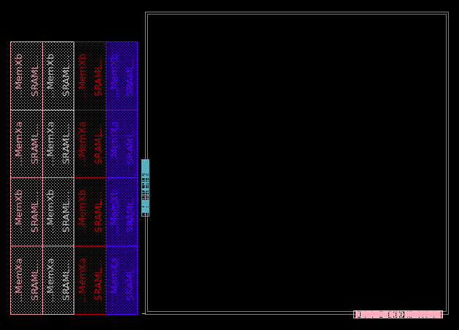
AFTER FLOORPLAN AND PORT PLACEMENT

Slide 6
Physical Design QOR Evaluation Metrics:
4) Macro placement Summary and QOR :
Block Name :
Macro Placement Summary
SI No | Parameter | Values
1 | Number of macro families | 04
2 | Maximum channel spacing | 15 units
3 | Type of blockage in channel | Soft
4 | Percentage of partial blockage in channel | None
5 | Number of times macro placement iterated | 4 times
6 | Congestion with final macro placement | 0.14%(Horizontal) 0.01%(vertical)

Slide 7
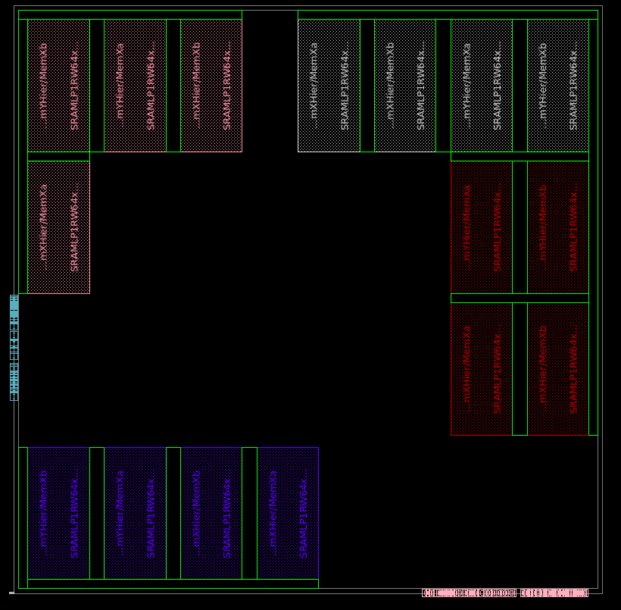
AFTER MACRO PLACEMENT

Slide 8
Physical Design QOR Evaluation Metrics:
5) Power Planning Summary and QOR :
Block Name :
Power Planning Summary
SI No | Parameters | Layers | Width | Set to set distance
1 | Rings | - | - | -
2 | Stripes | M2,M7,M8 | M2-0.192,M7-1.104,M8-4.64 | M2-3.648,M7-13.42,M8-19.45
3 | Rails | M1 | M1-0.66 | M1-1.672
Block Name :
Power Planning QOR
SI No | Parameter | Expected Value | Actual Value | Analysis | Controlled action | Final Metric
1 | No of PG DRC | 0 | 0 | When we used check_pg_drc -do_not_check_shapes_in_heiracical, we got none violations | - | -
2 | No of PG shorts | 0 | 0 | No violations | - | -
3 | No of PG connectivity violations | 0 | 0 | No violations | - | -

Slide 9
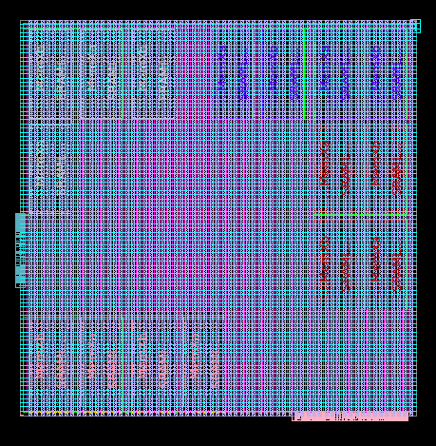
AFTER POWERPLAN

Slide 10
Physical Design QOR Evaluation Metrics:
6) Physical cell placement Summay :
Block Name :
Placement Summary
SI No | Parameters | Value
1 | Number of End cap cells | 0
2 | Number of TAP cells | 0
3 | TAP cells Interval | 30
4 | Number of DCAP Cells | 9024
5 | Number of spare cells | 0

Slide 11
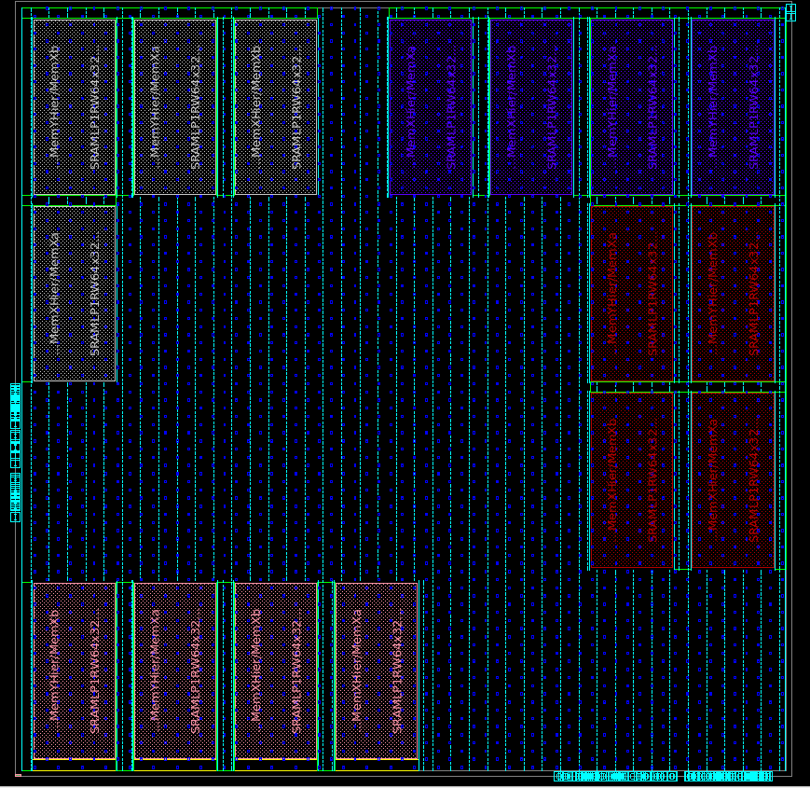
AFTER PHYSICAL CELL PLACEMENT

Slide 12
Physical Design QOR Evaluation Metrics:
7) Placement Summary and QOR :
Block Name :
Placement Summary
SI No | Parameters | Value
1 | Global max placement density | -
2 | Final Utilization | 63.46% (Overall utilization)
3 | Max_transition limit | 0
4 | Max_capacitance limit | 1
5 | Max_fanout limit | 30
6 | Final cell density | 34.54% (Cell utilization)
7 | Number of path groups | 6
8 | Number of TIEH cells | 266
9 | Number of TIEL cells | 150

Slide 13
Physical Design QOR Evaluation Metrics:
Placement summary and QOR Continued …..
Block Name :
Placement QOR
SI No | Parameter | Expected Value | Actual Value | Analysis | Controlled action | Final Metric
1 | Horizontal congestion percentage | 0 | 0.16% | We noticed that congestion is less | - | -
2 | Vertical congestion percentage | 0 | 0.01% | We noticed that congestion is less | - | -
3 | Number of Max_trans violation | 0 | 14 | We notice that more no of transition violations | We ran a TCL file for up size the cell | 0
4 | Number of Max_cap violation | 0 | 219 | We noticed that more no of capacitance violations | We ran a TCL file for inserting buffer at net length | 01
5 | Number of Max_fanout violations | 0 | 0 | - | - | -
6 | Setup (NVP) | 0 | No violation | - | - | -
7 | Setup (TNS ) | 0 | 0 | - | - | -

Slide 14
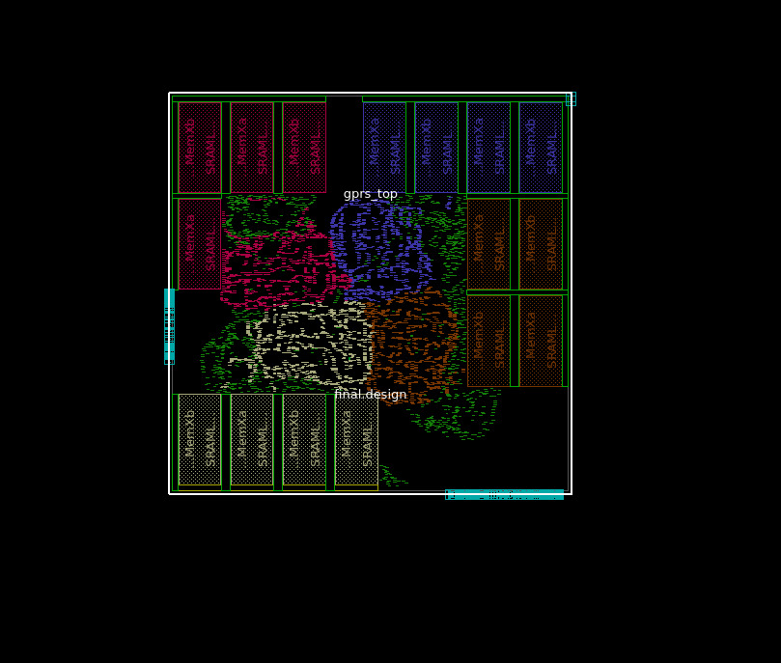
AFTER PLACEMENT

Slide 15
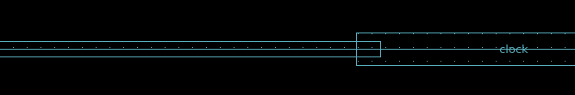
Physical Design QOR Evaluation Metrics:
8) CTS Summary and QOR :
Block Name :
CTS Summary
SI No | Clock groups | Period | Number of sinks | Numbers of buffers/Inverters | Target latency | Target skew | Max_trans limit | Max_cap limit | Max_fanout limit | Layers | NDR
1 | mclk | 4.00 | 2856 | 69/0 | 0.6 | 0.1 | 0.0674 | 71.1388 | 2856 | M6(max),M1(min) | M7 Multiplied by 2
2 | vclk | 4.00 | 0 | 0 | 0 | 0 | 0 | 0 | 0 | 0 | 0
CLOCK AFTER METAL M7 WIDTH AND SPACING MULTIPLIED BY 2

Slide 16
Physical Design QOR Evaluation Metrics:
CTS summary and QOR Continued …..
Block Name :
CTS QOR
Clock groups | Parameters | Expected Value | Actual Value | Analysis | Controlled action | Final Metric
Clock group 1 | Max_latency | 0 | 0.569 | Due to insertion of buffers and inverters | - | -
 | Global skew | 0 | 0.084 | Due to delay buffers | - | -
 | Max_trans violations | 0 | 0 | - | - | -
 | Max_cap violations | 0 | 0 | - | - | -
 | Max_fanout violations | 0 | 0 | - | - | -
Block Name :
CTS Timing QOR
SI No | Parameter | Expected Value | Actual Value | Analysis | Controlled action | Final Metric
1 | Setup (TNS ) | 0 | No violation | - | - | -
2 | Hold (TNS ) | 0 | -0.01 | The Negative slack is due to Reg-Reg path Negative slack | Prime time | Negligible

Slide 17
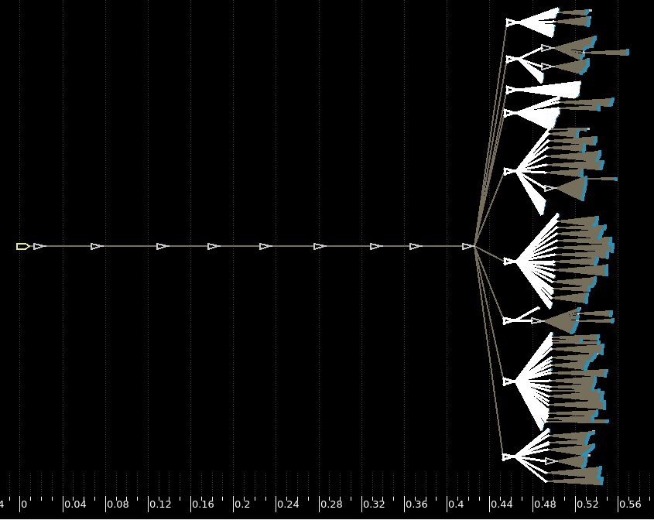
CLOCK TREE

Slide 18
Physical Design QOR Evaluation Metrics:
9) Routing Summary and QOR :
Block Name :
Routing QOR
SI No | Parameter | Expected Value | Actual Value | Analysis | Controlled action | Final Metric
1 | Number of shorts | 0 | 3 | Due to overlapping of M6 layer in Macro | Avoid the short by using M7 | 0
2 | Number of opens | 0 | 0 | check_lvs -max_errors 0 | - | -
3 | Number of DRC violations | 0 | 0 | check_route | - | -
4 | Number of PG shorts | 0 | 0 | check_pg_drc -do_not_check_shapes_in_hier_blocks | - | -
5 | Number of antenna violations | 0 | - | - | - | -
6 | Max_trans violations | 0 | 08 | Due to Routing and CTS | Prime Time | Yet to be Done
7 | Max_cap violations | 0 | 123 | Due to Routing and CTS | Prime Time | Yet to be Done
8 | Max_fanout_violations | 0 | 41 | Due to CTS | Prime Time | Yet to be Done
9 | Setup (TNS) | 0 | 0 | report_global_timing | - | -
10 | Hold (TNS ) | 0 | -14.81 | Due to Reg-Reg path | route_opt | -0.01

Slide 19
Physical Design QOR Evaluation Metrics:
10) Final QOR :
Block Name :
Routing QOR
SI No | Parameter | Floorplan | Placement | CTS | Routing | After Timing ECO
1 | Number of cells | 27948 | 32520 | 35478 | 35478
2 | Utilization | 34.91%(Cell) 60.41%(Overall) | 34.27%(Cell) 63.46%(Overall) | 40.76%(Cell) 67.24%(Overall) | 40.86%(Cell) 67.30%(Overall)
3 | Congestion | 0% | 0.16% | 0.68% | 5.80%
4 | Max_trans violations | 0 | 0 | 1 | 8
5 | Max_cap violations | 450 | 14 | 71 | 123
6 | Max_fanout_violations | - | - | 41 (lowest - (31) ZCTSNET_31, highest - (134) ZCTSNET_76) | 41 (lowest - (31) ZCTSNET_31, highest - (134) ZCTSNET_76)
7 | Setup (NPV) | 0 | 0 | 0 | 0
8 | Setup (WNS) | No violations | No violations | No violations | No violations
9 | Hold (TNS ) | 0 | -238.36 (reg-reg) | -0.95 (reg-reg) | -14.81 (reg-reg)
10 | Hold (WNS) | No violations | -0.18 (reg-reg) | -0.18 (reg-reg) | -0.09 (reg-reg)

Slide 20
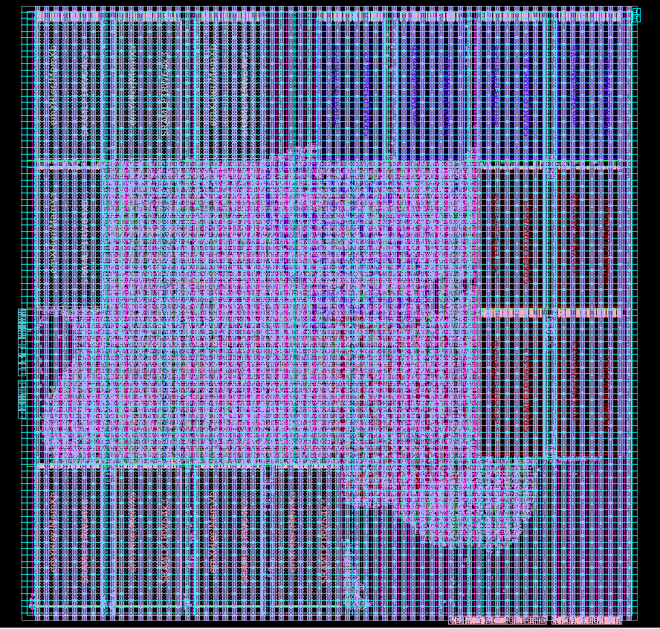
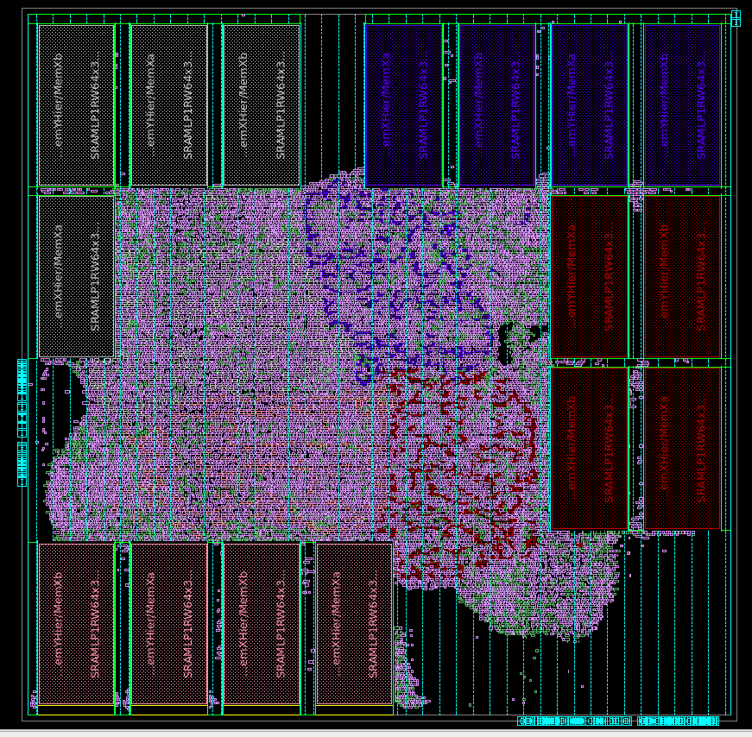
FINAL DESIGN OF GENERAL PURPOSE SHIFT REGISTER

Slide 21
Timing Signoff QOR Evaluation Metrics:
1) Timing Signoff QOR Evaluation Metrics:
Block Name :
Timing exceptions (check timing report )
Modes names | Timing exceptions | Value | Validated remarks
Func mode | Number of False paths | 0 | No False path defined
 | Number of Disabled timing/Case constant | 0 | No such Constants
 | Number of Asynchronous clock paths | 0 | Single clock domain design; no asynchronous paths exist.
 | Number of flip-flops without fan in clocks | 0 | All sequential elements in the design are properly driven by a clock signal.
 | Number of multicycle paths | 0 | No multicycle paths defined.
Test mode | Number of False paths | N/A | N/A
 | Number of Disabled timing/Case constant | N/A | N/A
 | Number of Asynchronous clock paths | N/A | N/A
 | Number of flip-flops without fan in clocks | N/A | N/A
 | Number of multicycle paths | N/A | N/A

Slide 22
Timing Signoff QOR Evaluation Metrics:
Timing signoff Summary and QOR :
Block Name :
Timing signoff QOR
SI No | Parameter | Expected Value | Actual Value | Analysis | Controlled action | Final Metric
1 | Max_trans violations | 0 | 3 | Marginal limits (Slack ~0.00). | Upsize drivers or insert buffers. | 0
2 | Max_cap violations | 0 | 347 | Unbuffered memory outputs causing high fanout. | Targeted ECO buffer insertion on remaining nets. | 10
3 | Max_fanout_violations | 0 | 0 | - | - | 0
4 | Setup (TNS) | 0 | -61.02 | Setup greatly improved. WNS is -2.30ns on mclk across 77 paths. | Upsize drivers or restructure logic on remaining critical paths. | -61.02
5 | Hold (TNS ) | 0 | -480.78 | Hold violations persist on mclk domain (2,513 paths) | Insert delay buffers on fast paths (Hold ECO). | -480.78
6 | Crosstalk noise | 0 | 0 | Clean; no crosstalk noise violations detected (0 nets failed above_low/below_high margins). | None required. | 0

